Slide 1
Lecture #14
SOFT COMPUTING
INT508

Slide 2
FUZZY LOGIC
  The 'Fuzzy' word means the things that are not clear.
  Fuzzy logic contains the multiple logical values and these values are the truth values of a variable or problem between 0 and 1.
  This concept was introduced by Lofti Zadeh in 1965 based on the Fuzzy Set Theory.
  This concept provides the possibilities which are not given by computers, but similar to the range of possibilities generated by humans.
  Fuzzy logic is the logic underlying approximate, rather than exact, modes of reasoning.
  It contains as special cases not only the classical two-value logic and multivalue logic systems, but also probabilistic logic.
  A proposition p has a truth value-0 or 1 in two-value system, element of a set T in multivalue system.

Slide 3
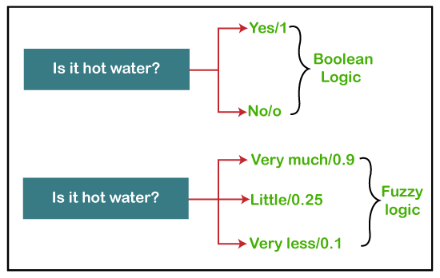
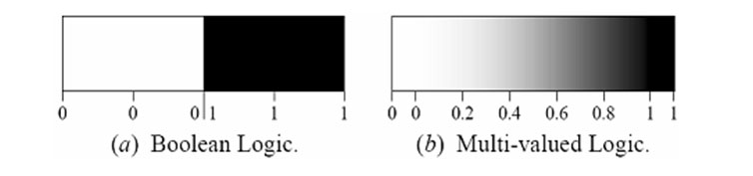
FUZZY LOGIC
  Boolean logic uses sharp distinctions.
  Fuzzy logic reflects how people think.
  Fuzzy logic is a set of mathematical principles for knowledge representation and reasoning based on degrees of membership.

Slide 4
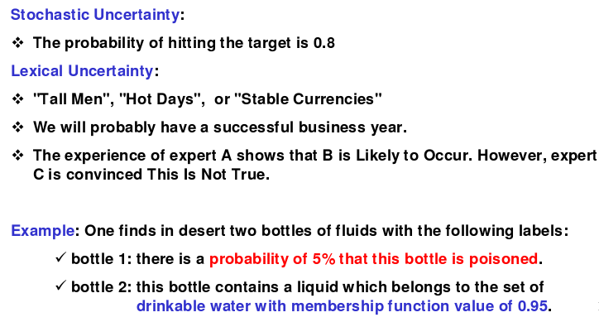
TYPES AND MODELING OF UNCERTAINTY
  Fuzzy ≠ Probability
  Probability deals with uncertainty an likelihood
  Fuzzy logic deals with ambiguity an vagueness

Slide 5
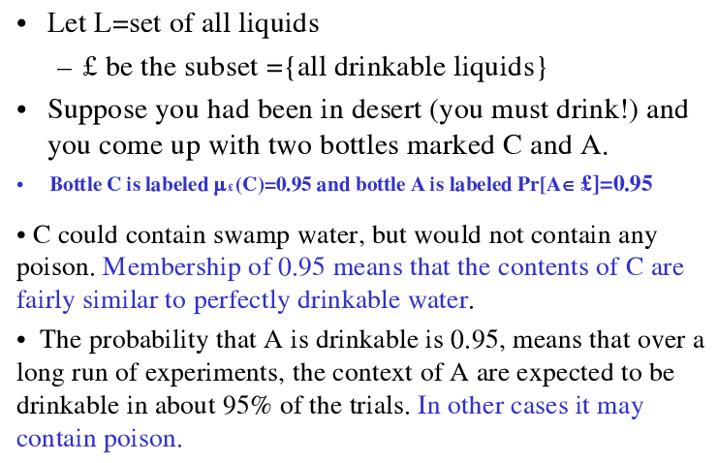

Slide 6
NEED OF FUZZY LOGIC
This concept is flexible and we can easily understand and implement it.
It is used for helping the minimization of the logics created by the human.
It is the best method for finding the solution of those problems which are suitable for approximate or uncertain reasoning.
It always offers two values, which denote the two possible solutions for a problem and statement.
It allows users to build or create the functions which are non-linear of arbitrary complexity.
In fuzzy logic, everything is a matter of degree.
In the Fuzzy logic, any system which is logical can be easily fuzzified.
It is based on natural language processing.
It is also used by the quantitative analysts for improving their algorithm's execution.
It also allows users to integrate with the programming.

Slide 7
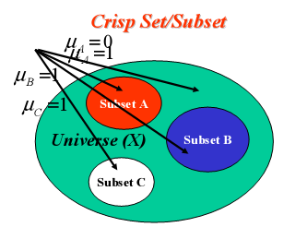
CLASSICAL SETS (CRISP SETS)
Conventional or crisp sets are Binary. An element either belongs to the set or does not. {True, False} {1, 0}

Slide 8
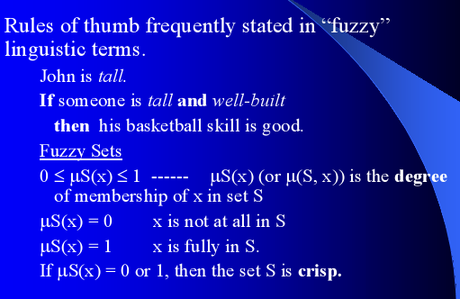
FUZZY SETS

Slide 9
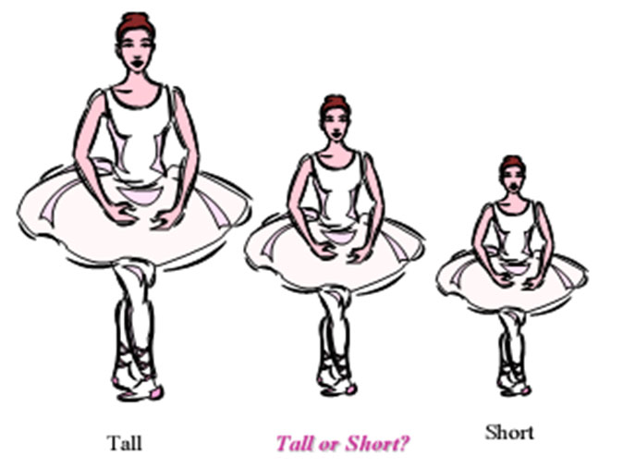
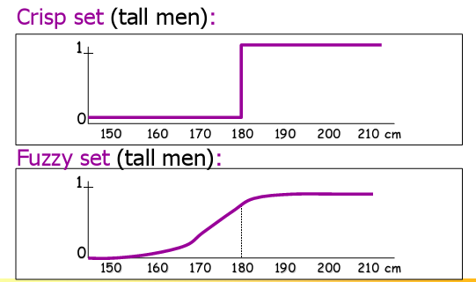

Slide 10
Classical Set Theory | Fuzzy Set Theory
1. This theory is a class of those sets having sharp boundaries. | 1. This theory is a class of those sets having un-sharp boundaries.
2. This set theory is defined by exact boundaries only 0 and 1. | 2. This set theory is defined by ambiguous boundaries.
3. In this theory, there is no uncertainty about the boundary's location of a set. | 3. In this theory, there always exists uncertainty about the boundary's location of a set.
4. This theory is widely used in the design of digital systems. | 4. It is mainly used for fuzzy controllers.

Slide 11
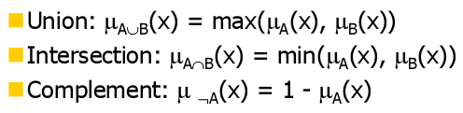
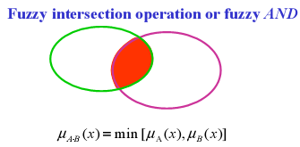
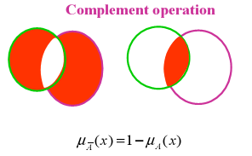
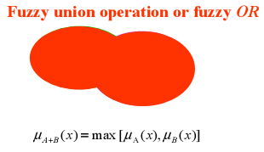
OPERATIONS ON FUZZY SETS
Example: μA(x)={0.4,05,0.8,0.2}, μB(x)={0.3,0.6,0.4,0.7}
μA ∪B(x)={0.4,0.6,0.8,0.7}
μA ∩B(x)={0.3,0.5,0.4,0.2}
Complement of μA(x)={0.6,05,0.2,0.8}& μB(x)={0.7,0.4,0.6,0.3}

Slide 12
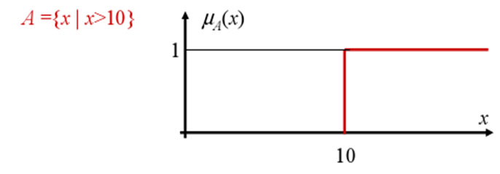
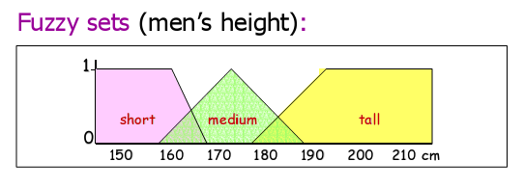
CRISP MEMBERSHIP FUCNTIONS
  Crisp membership functions (μ) are either one or zero.
  Consider the example: Numbers greater than 10. The membership curve for the set A is given by

Slide 13
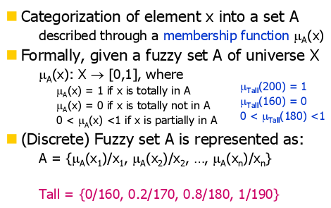
FUZZY MEMBERSHIP FUCNTIONS

Slide 14
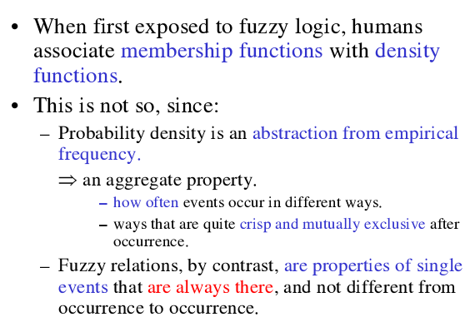
FUZZINESS vs PROBABILITY

Slide 15
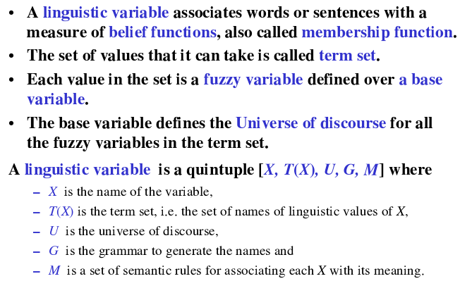
LINGUISTIC VARIABLE

Slide 16
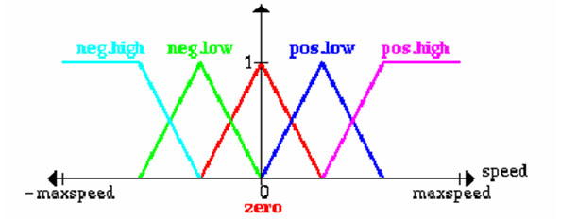
LINGUISTIC VARIABLE
Let x be a linguistic variable with the label “speed”.
Terms of x, which are fuzzy sets, could be “positive low”, “negative high” from the term set T:
T = {PostiveHigh, PositiveLow, NegativeLow, NegativeHigh, Zero}
Each term is a fuzzy variable defined on the base variable which might be the scale of all relevant velocities.

Slide 17
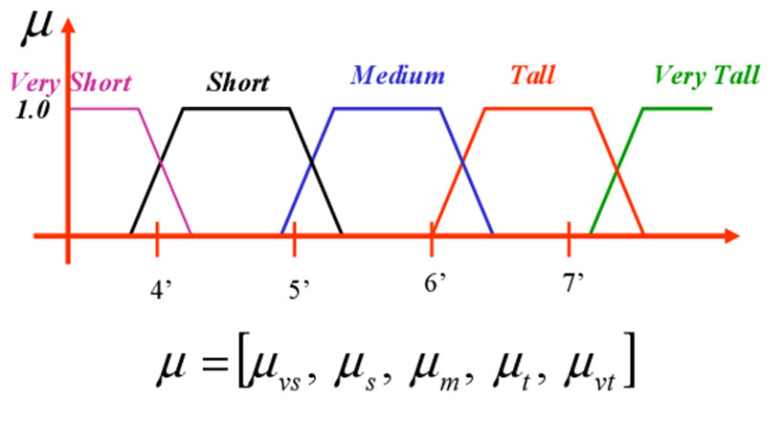
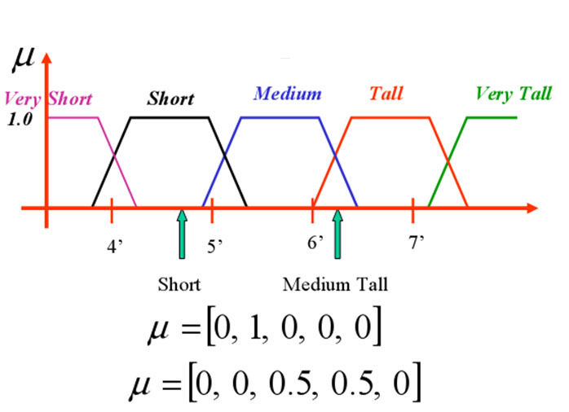
MEMBERSHIP FUCNTIONS

Slide 18
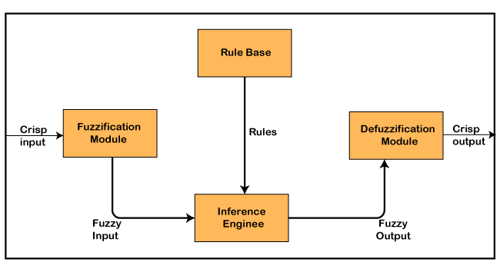
Architecture of a Fuzzy Logic

Slide 19
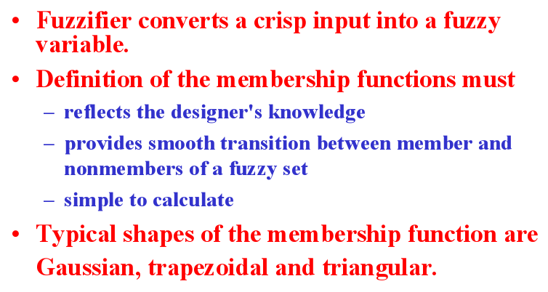
FUZZIFICATION

Slide 20
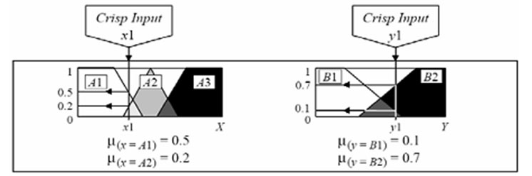
Use crisp inputs from the user.
Determine membership values for all the relevant classes (i.e., in right Universe of Discourse).

Slide 21
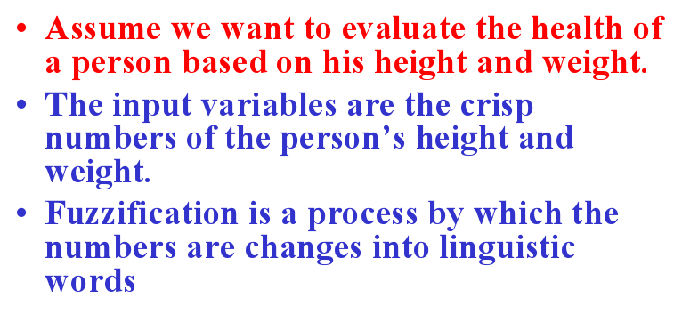
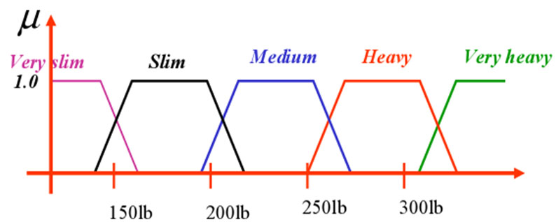
EXAMPLE - FUZZIFICATION
FUZZIFICATION
OF HEIGHT

Slide 22
FUZZIFICATION OF WEIGHT

Slide 23

12/12/14
CSE510, Lovely Professional University, Phagwara

